Slide 1
Keeping Babies & Toddlers Safe from Foodborne Illness
www.fightbac.org/kids

Slide 2
Learning Objectives
1. Why your baby or toddler is at risk for a foodborne illness
2. Tips to reduce risk among young children
3. Resources for parents and caregivers

Slide 3
Young Children are Vulnerable
Each year an estimated 300,000 illnesses affect children under age 5 in the U.S.
A child’s immune system is not fully developed
An underdeveloped immune system makes it difficult for young children to fight off infection
Sources: Centers for Disease Control and Prevention, U.S. Food and Drug Administration

Slide 4
Young Children are Vulnerable
Children under age 5 experience the highest rate of any age group for getting sick from these germs:
Campylobacter
E. coli O157
Salmonella
Shigella
Sources: Centers for Disease Control and Prevention, U.S. Food and Drug Administration

Slide 5
Special Risks for Young Children
Children under age 5 have a higher likelihood of E. coli evolving into Hemolytic Uremic Syndrome (HUS)
HUS is a severe E. coli complication that can lead to kidney failure and death
Risk of developing HUS:
Healthy people – 6%
Children under age 5 – 15%
Sources: Centers for Disease Control and Prevention, U.S. Food and Drug Administration

Slide 6
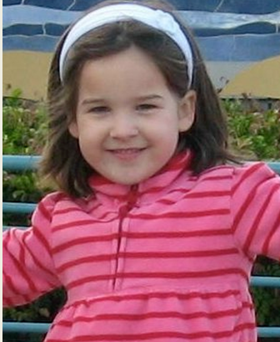
More about HUS
HUS is a leading cause of acute kidney failure in children under age 5
Long-term health outcomes:
Kidney failure (20─30%)
High blood pressure (8–12%)
Diabetes (0–15%)
Sources: Centers for Disease Control and Prevention, U.S. Food and Drug Administration
Ashley
E.coli O157:H7
Courtesy of STOP Foodborne Illness
Notes:
Stress that long-term health outcomes are serious, and effects that child’s quality of life.

Slide 7
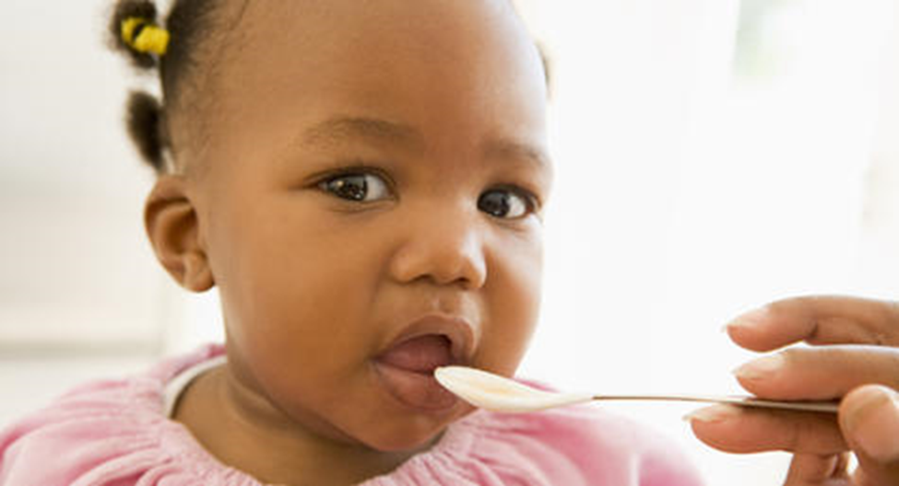
Keep Your Baby or Toddler Safe
5
Tips
Here are five important tips for keeping babies and toddlers safe from foodborne illness.

Slide 8
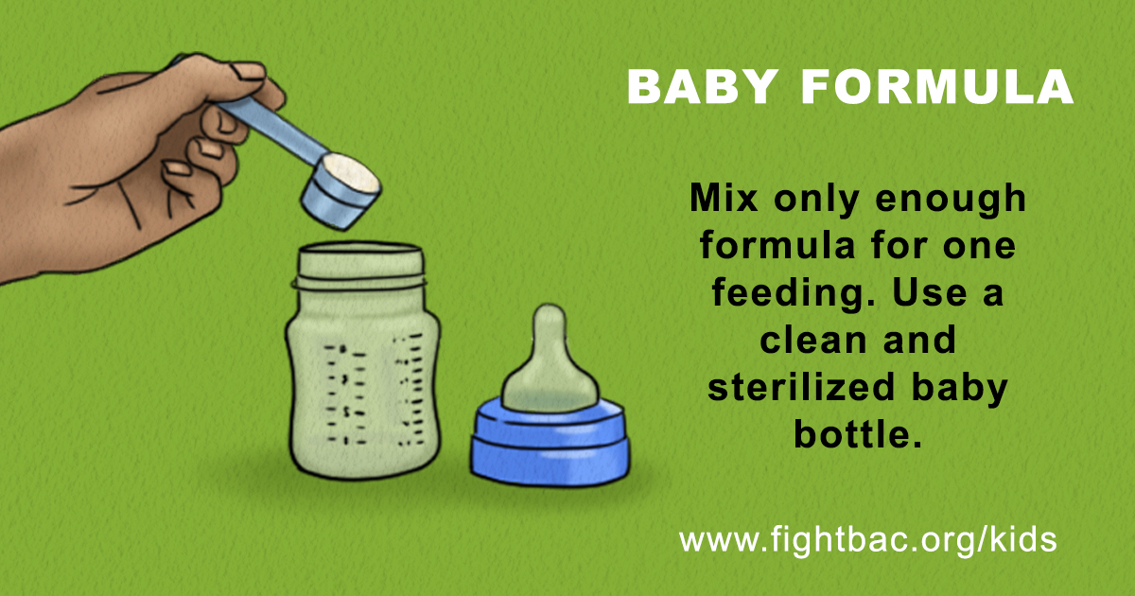
Tip #1
Notes:
Infant formula also has inherent risks. Like breast milk, formula is not a sterile product. Furthermore, milk-based infant formula contains lactose, protein, and milk fat that may protect bacteria during the drying process. These sublethally injured microorganisms have been reported to survive for up to two years.

Slide 9
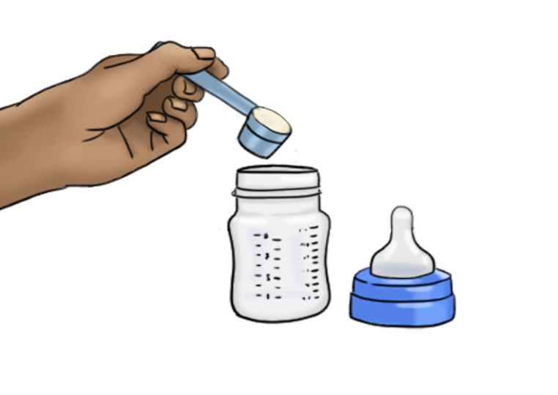
Baby Formula Tips
Use a clean bottle that has been sterilized in boiling water.
Mix only enough formula for one feeding.
Do not add new formula to a half-filled bottle.
After feeding baby, throw out any formula or breast milk that is left over.

Slide 10
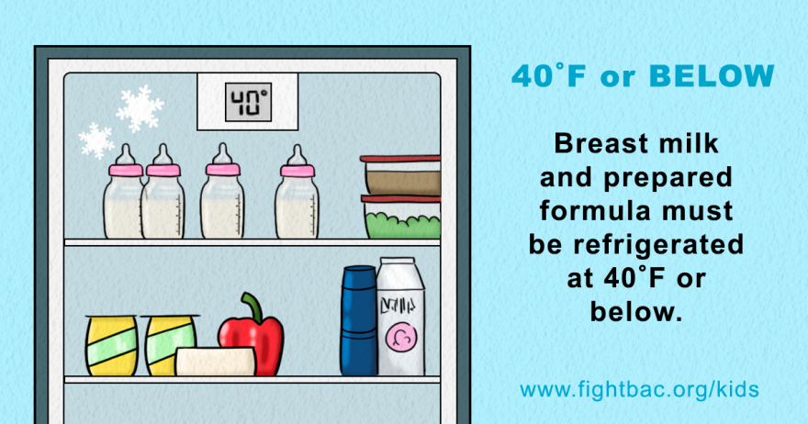
Tip #2

Slide 11
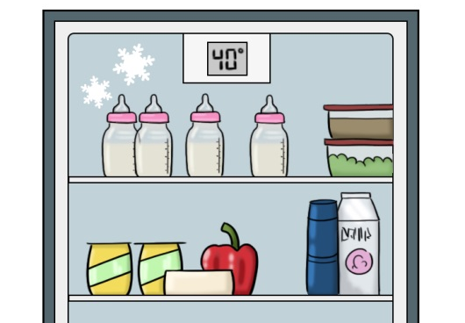
Milk & Prepared Formula Tips
Milk and prepared formula are susceptible to bacterial contamination if they are not handled and stored properly.
Breast milk and prepared formula must be refrigerated at 40 °F or below.
Use an appliance thermometer to make sure your refrigerator is at 40 °F or below.

Slide 12
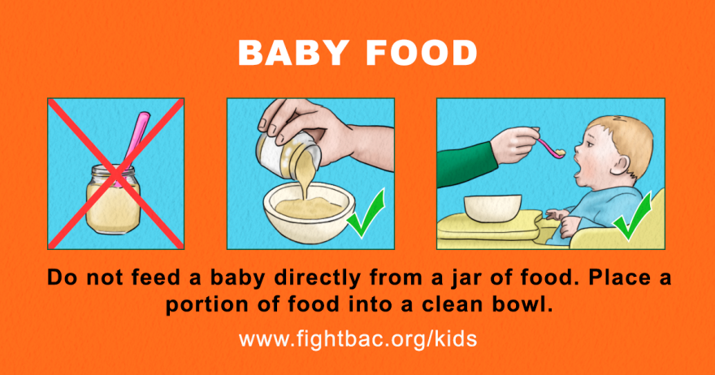
Tip #3

Slide 13
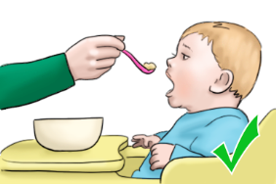
Baby Food Tips
Do not feed a baby directly from a jar of food.
Use a clean spoon to take out a portion of food.
Place the food in a clean bowl.

Slide 14
Baby Food Tips
Refrigerate unserved portions of baby food in the original container or jar at 40 °F or below.
Label the jar with the date it was opened. Use within three days.

Slide 15
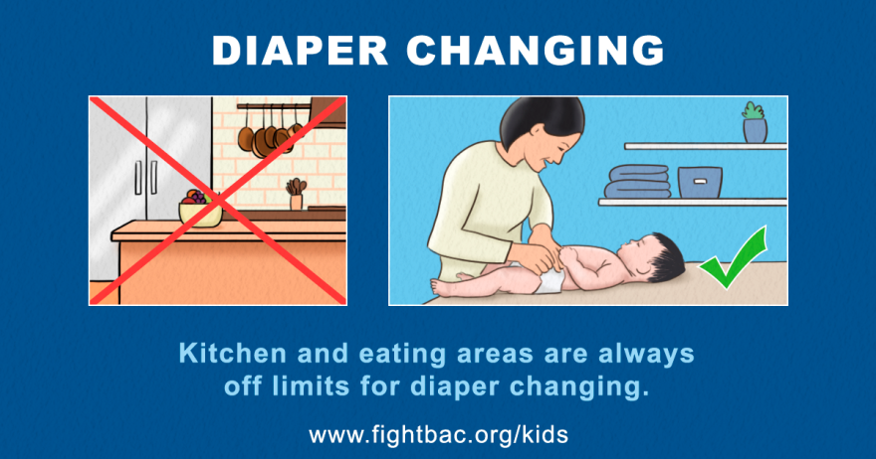
Tip #4

Slide 16
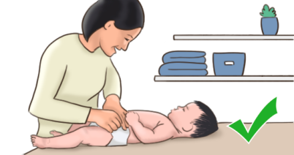
Diaper Changing Tips
Kitchen and eating areas are always off limits for diaper changing.
Always change diapers in the same location in your home to keep any germs confined to one area.
Wash your hands and your child’s hands with soap and water after changing the diaper.

Slide 17
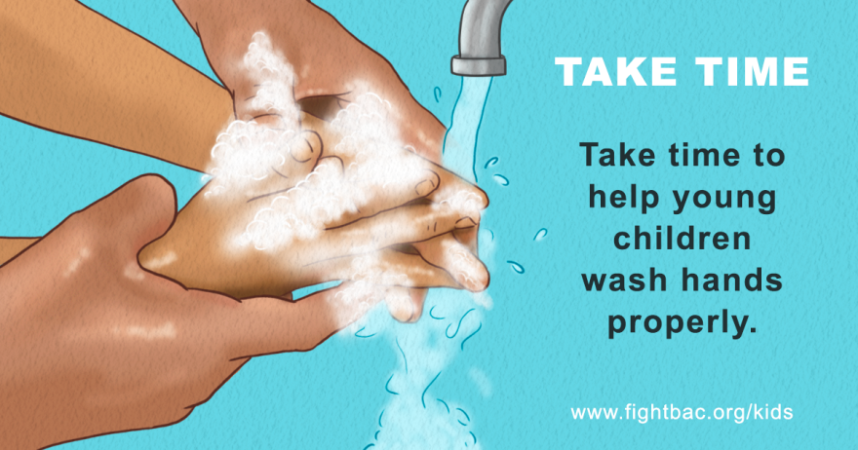
Tip #5

Slide 18
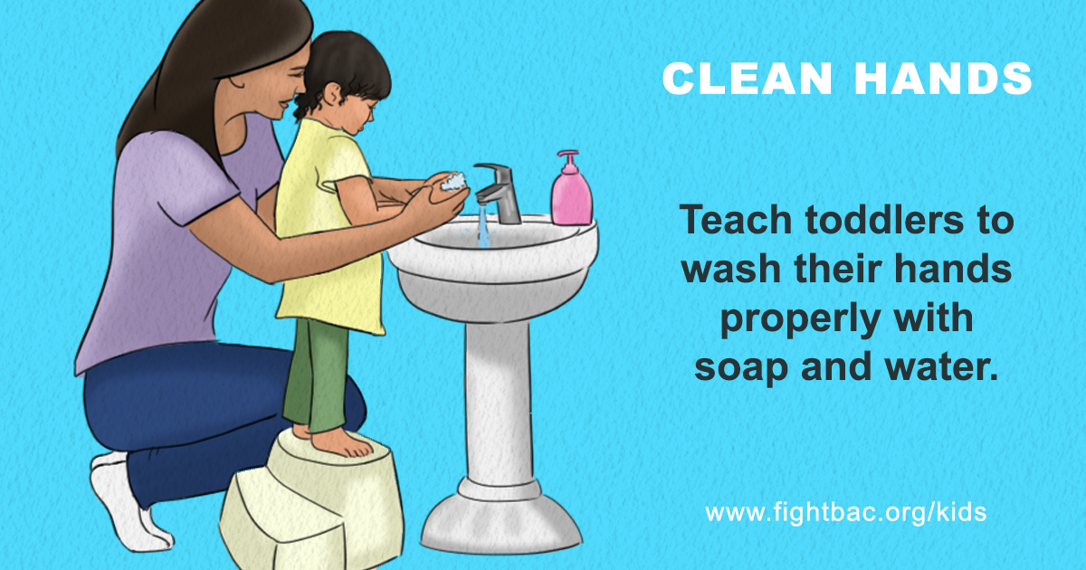

Slide 19
Handwashing Steps
Wet your hands with clean, running water (warm or cold), turn off the tap, and apply soap.
Lather your hands by rubbing them together with the soap. Be sure to lather the backs of your hands, between your fingers, and under your nails.
Scrub your hands for at least 20 seconds. Need a timer? Hum the “Happy Birthday” song from beginning to end twice.
Rinse your hands well under clean, running water.
Dry your hands using a clean towel or air dry them.

Slide 20
Be Consistent!
Leaving a bottle out at room temperature can increase the risk of foodborne illness for your baby.
Use breast milk and prepared formula within 48 hours.
Do not feed a baby directly from a jar of food. Use a clean spoon to place the food in a clean bowl.
Kitchen and eating areas are always off limits for diaper changing.
Take time to help young children learn to wash their hands properly with soap and water.

Slide 21
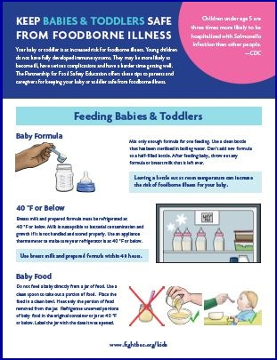
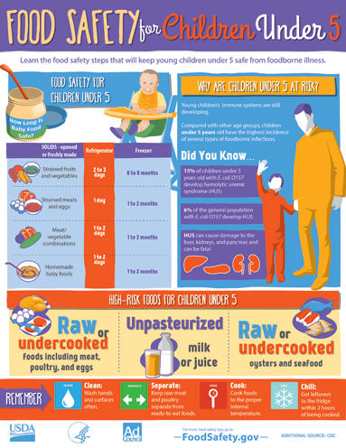
Download Free Flyers
www.fightbac.org/kids
www.foodsafety.gov

Slide 22
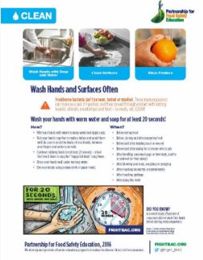
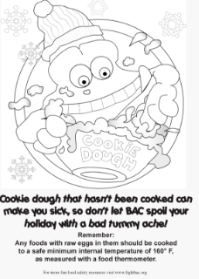
More Free Resources
Food safety fact sheets
Recipes – print and videos
Child care training
Kids’ activity sheets
Coloring pages
www.fightbac.org

Slide 23
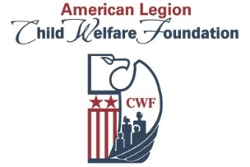
Thank You!
facebook.com/FightBAC
@Fight_BAC
Presenter Name Presenter Title Organization Phone Number Email Address
“Keeping Babies & Toddlers Safe from Foodborne Illness” outreach is supported by a grant from the American Legion Child Welfare Foundation.

