Slide 1
CDC and Food Safety
Website Updates and Communication Resources
Elizabeth Greene
Associate Director for Communication
DFWED Office of the Director
ite6@cdc.gov
National Center for Emerging and Zoonotic Infectious Diseases
Division of Foodborne, Waterborne, and Environmental Diseases

Slide 2
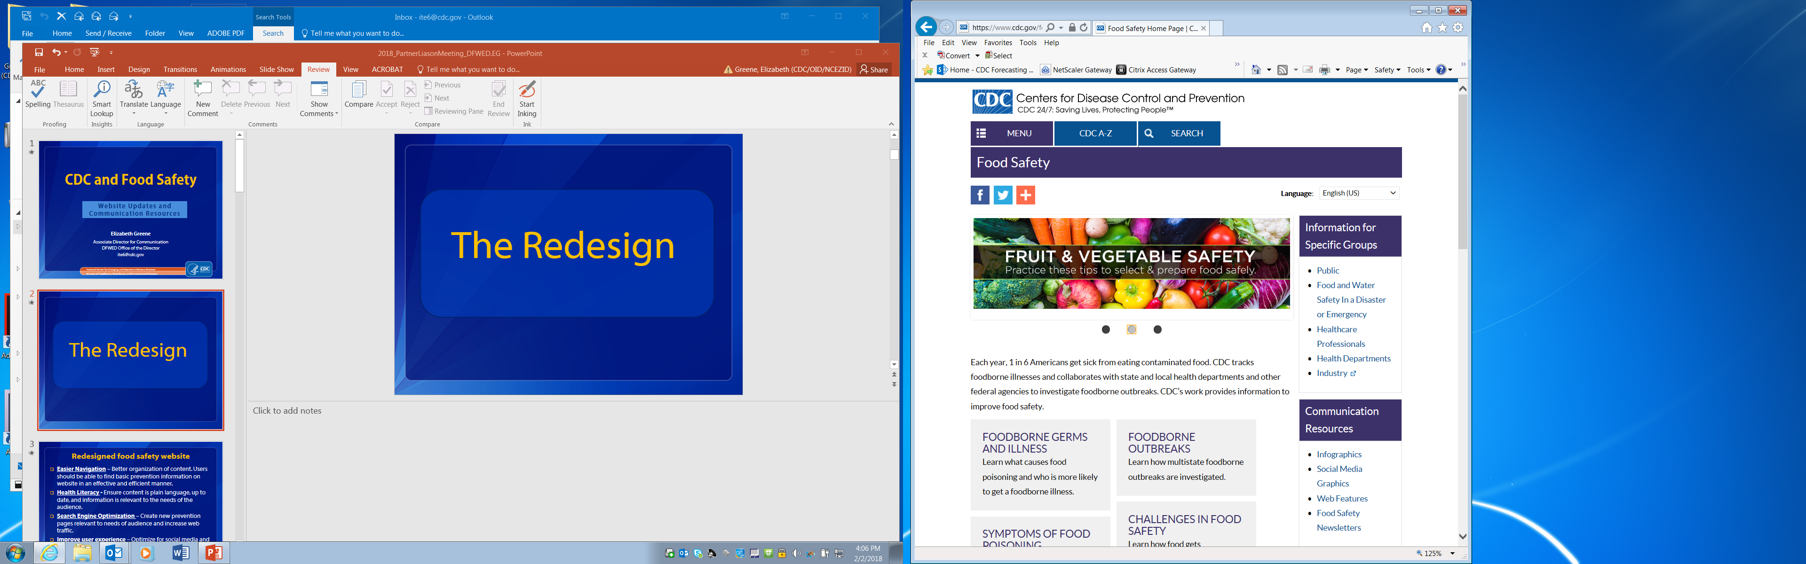
Food safety website
Notes:
Redesigned in 2017 to include more information that people were looking for. Information sources: CDC-INFO questions, and searches on topics like food safety, preventing food poisoning, and symptoms of foodborne illness. We looked at searches on the CDC website and on the external web.

Slide 3

Redesign goals
More content targeted
to user needs
Easier navigation
Plain language
Search engine optimization
Improve user experience
Mobile friendly
Social media friendly
More visuals
Notes:
Outbreak notices can drive traffic into our pages and media coverage amplifies the general public’s awareness of an outbreak. Given that there can be multiple food outbreaks a year, it is vital to make general prevention information easily accessible.
Question: How did we make this more social media friendly?

Slide 4
Site changes
More information on topics consumers were looking for
New pages on symptoms, how to keep food safe, and foods linked to illness.
Reorganized communication resources to make graphics, feature articles easier to find and share
New content navigation
Translated into Spanish
More links to relevant information from partner federal agencies
Notes:
Launched website in September 2017, before National Food Safety Education Month

Slide 5
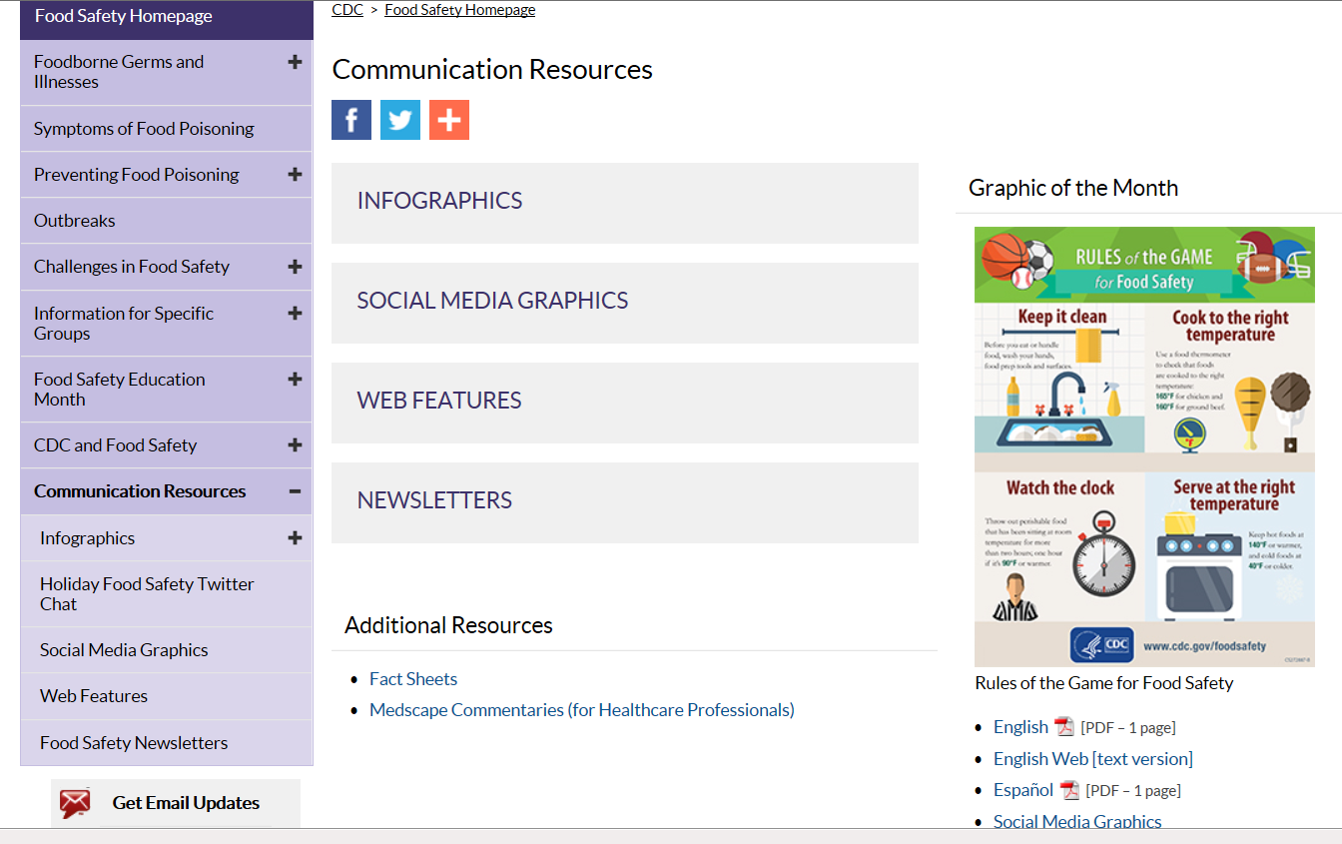
Communication resources and educational materials

Slide 6
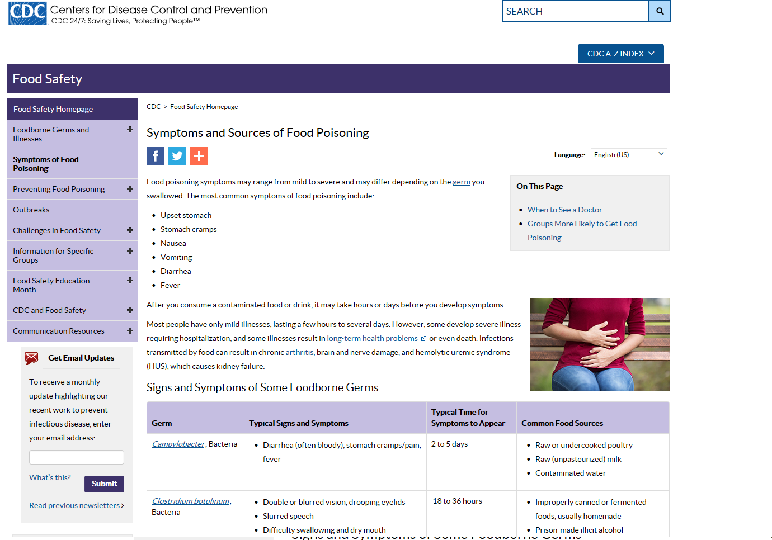
New page on foodborne illness symptoms

Slide 7
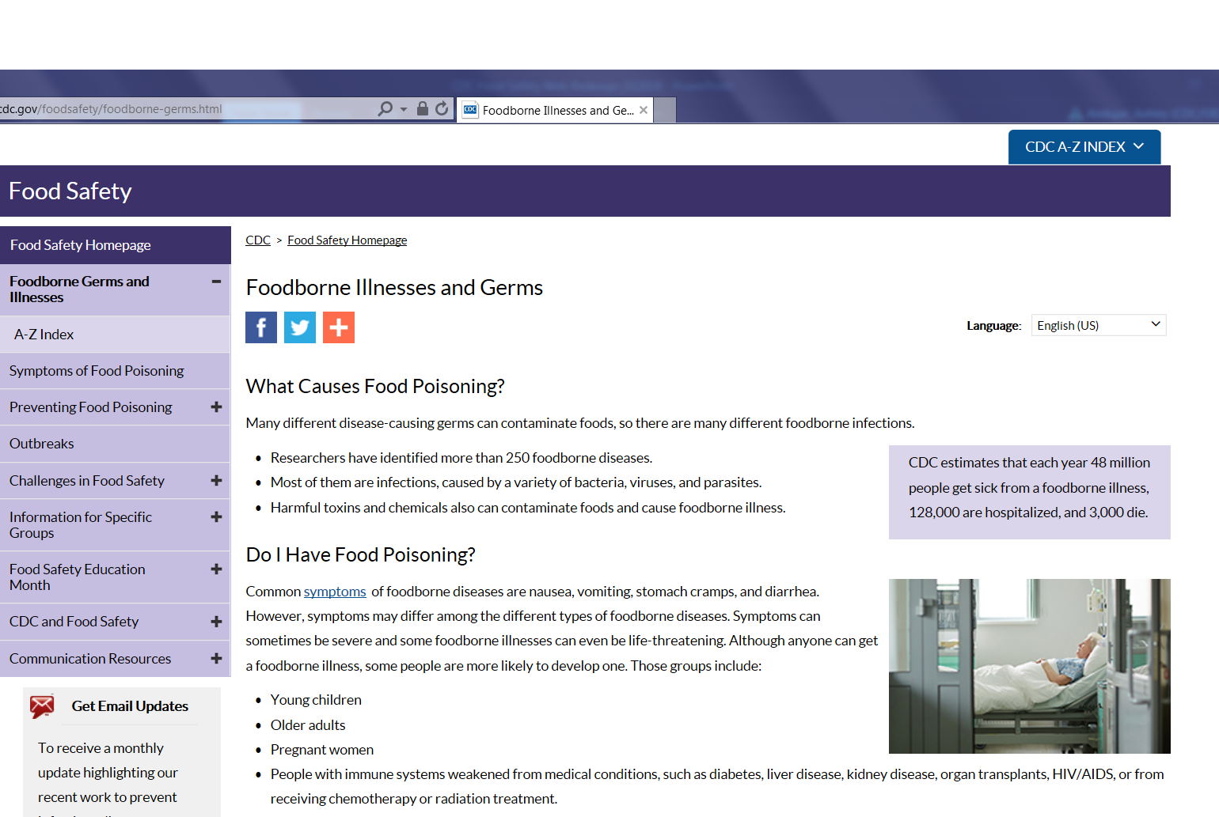
Revised page on foodborne germs and illness
Before
After

Slide 8
More information on the 4 steps
Before
After

Slide 9
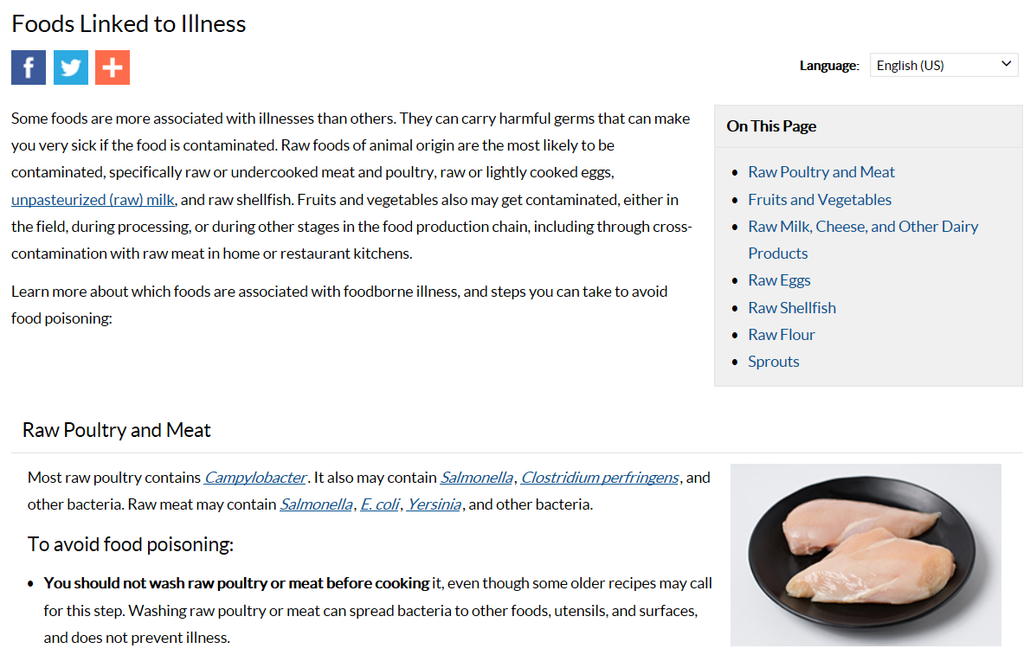
More info on foods linked to illness

Slide 10
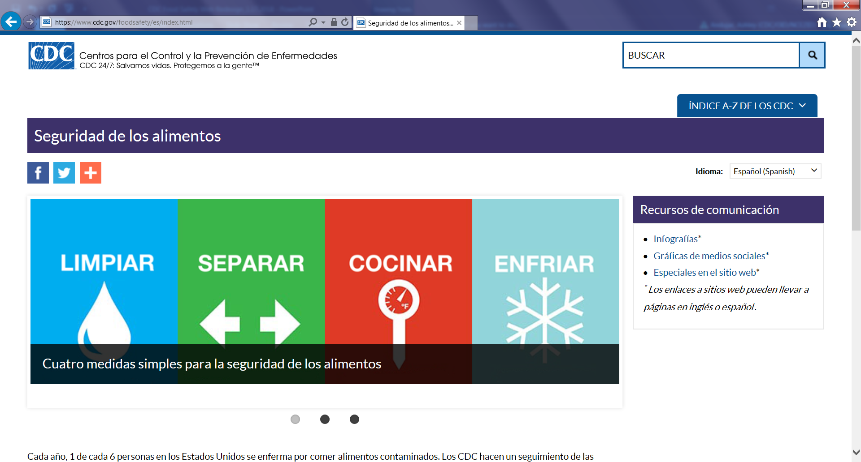
Website available in Spanish

Slide 11
Food Safety Communication Resources
www.cdc.gov/foodsafety/communication

Slide 12
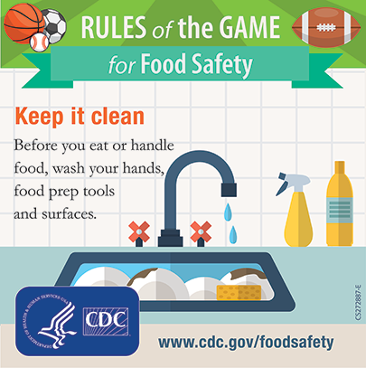
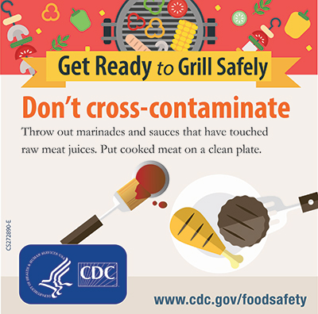
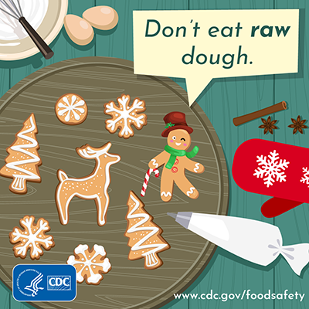

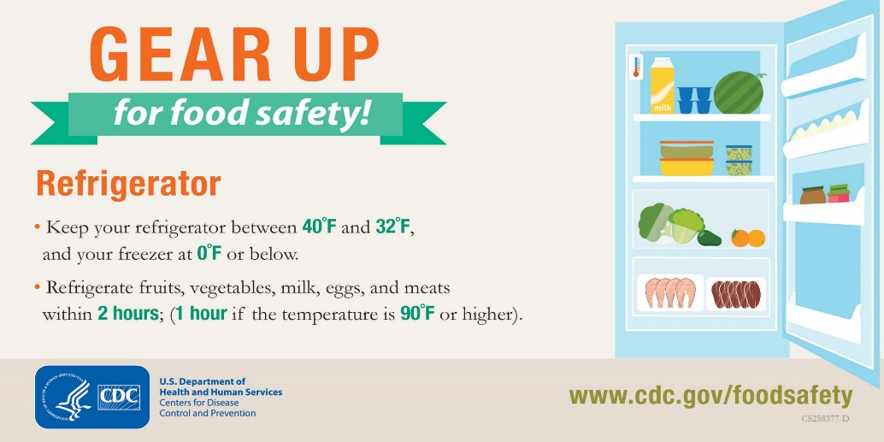
Social Media and infographics

Slide 13

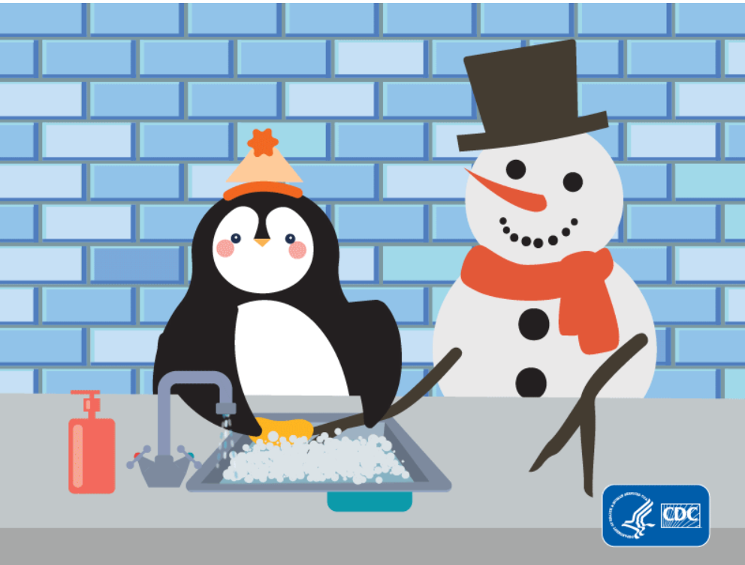
Videos and GIFs

Slide 14
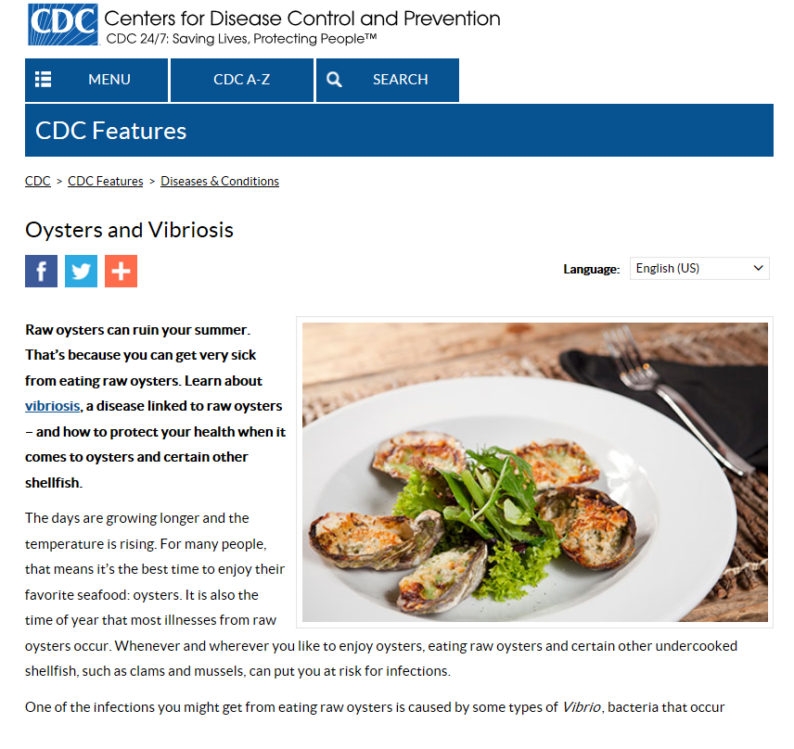
CDC web features
More than 20 web
features on food safety
and related topics
(handwashing,
antibiotic resistance)
Spanish translations

Slide 15
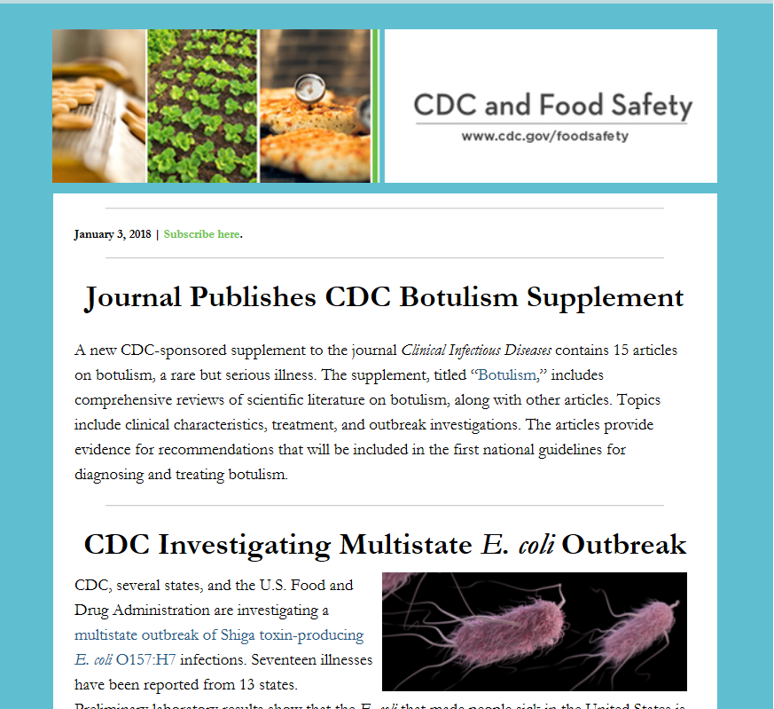
CDC and Food Safety newsletter
Subscribe on cdc.gov/foodsafety

Slide 16
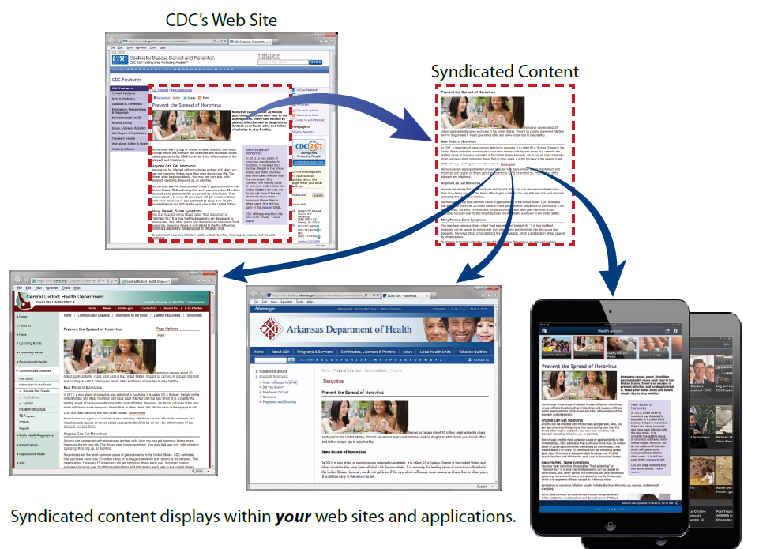
Content syndication
Add CDC content directly
to websites and apps
Content updates
automatically
Simple process
www.cdc.gov/syndication

Slide 17
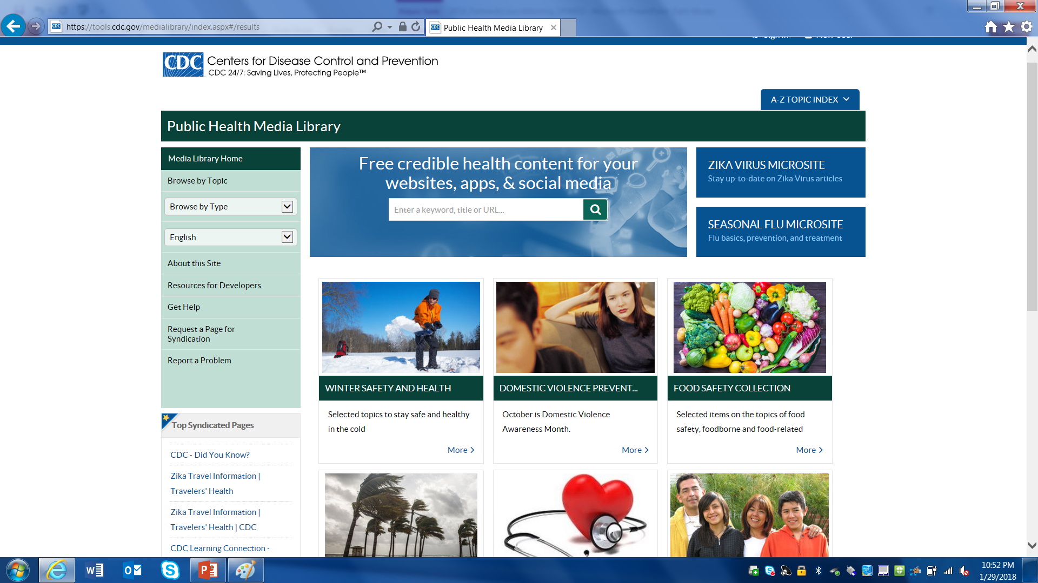
Content syndication

Slide 18
Questions?
Elizabeth Greene
404-639-3459
ite6@cdc.gov
National Center for Emerging and Zoonotic Infectious Diseases
Division of Foodborne, Waterborne, and Environmental Diseases

