Slide 1
Food Safety Research Information Office (FSRIO)
February 8, 2018

Slide 2
FSRIO Overview
The Food Safety Research Information Office (FSRIO) was created by the Agricultural Research, Extension and Education Reform Act of 1998. FSRIO was formally launched on July 2, 2001.
Our mission is to provide the food safety research community and general public with information on publicly and privately funded food safety research. FSRIO works to assist the federal government and private research entities in the assessment of food safety research needs and priorities, and to prevent unintended duplication of food safety research. FSRIO works in cooperation with the National Institutes of Health, the Food and Drug Administration, the Centers for Disease Control and Prevention, public institutions, and, on a voluntary basis, private research interests.

Slide 3
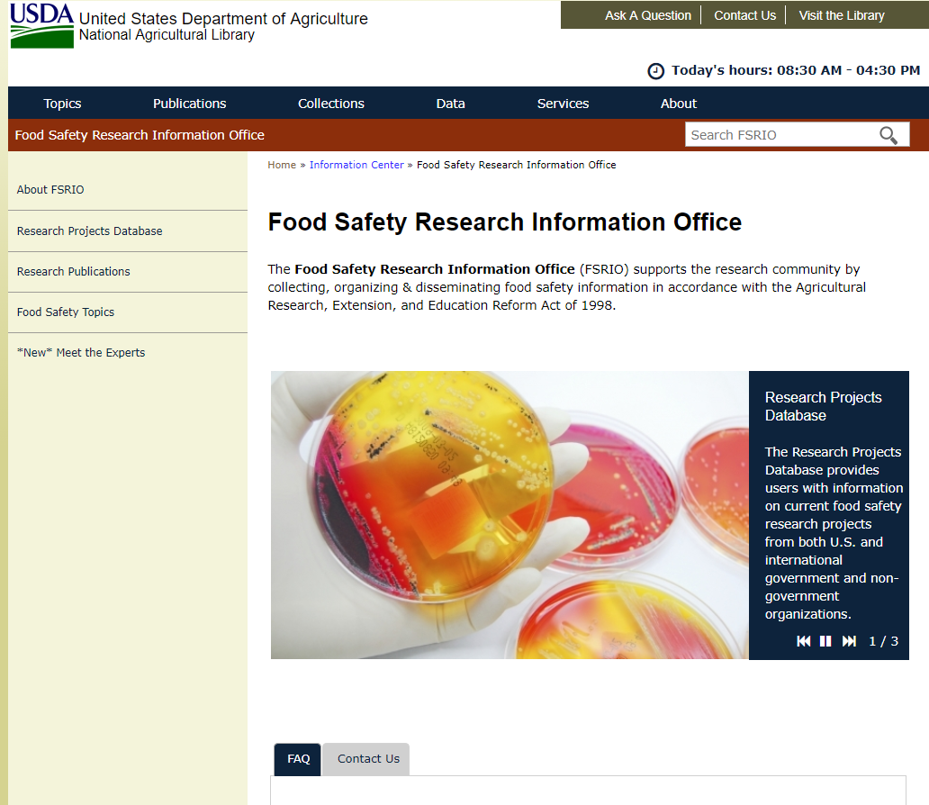
Food Safety Research Information Office (FSRIO)
Formally launched in 2001
Support the research community by collecting, organizing and disseminating food safety research information
Partnership with ARS National Program 108: Food Safety, (animal and plant products)

Slide 4
FSRIO
Mandated by Congress to:
Support the needs of the research community
Provide information on publicly funded, and to
the extent possible, privately funded food
safety research initiatives for the purpose of:
preventing unintended duplication of food safety research
assisting the executive and legislative branches of the Government and private research entities to assess food safety research needs and priorities.

Slide 5
Key Information Products:
Food Safety Research Projects Database
Research Publication Feeds
Meet the Experts Page

Slide 6
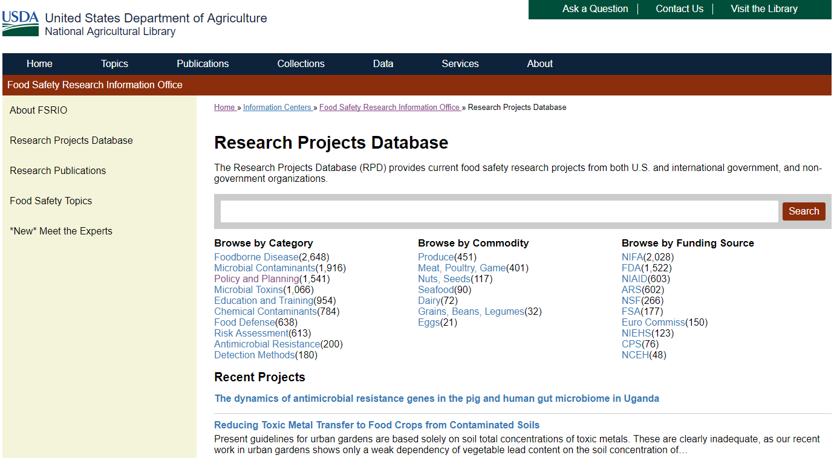
Research Projects Database
Extensive collection of food safety research projects across agencies and organizations
Includes more than12,000 active and completed projects funded by U.S. and international government agencies, and private organizations
Ongoing collection of research projects through partnerships with government agencies, educational institutions and other organizations.

Slide 7
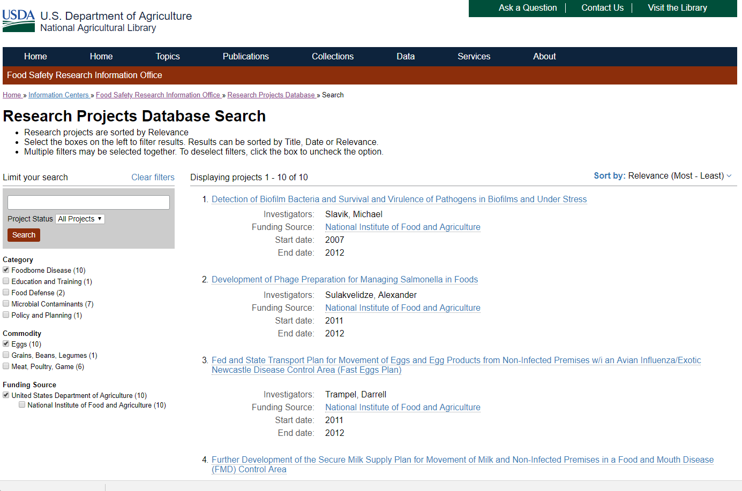
Research Projects Database
Browse food safety categories, commodities, and funding sources from the homepage.
Dynamic filtering in advance search allows you to choose any combination of categories, food types, and funding agencies.
New feature that allows you to sort by relevance, date, or title.

Slide 8
Research Projects Database
Advanced Filtering
Categories
Food Commodity
Funding Source
Antimicrobial Resistance
Chemical Contaminants
Detection Methods
Foodborne Disease
Food Defense
Microbial Contaminants
Microbial Toxins
Dairy
Eggs
Grains, Beans, Legumes
Meat, Poultry, Game
Nuts, Seeds
Produce
Seafood
Agricultural Research Service
Centers for Disease Control
Food and Drug Administration
National Institute of Food and Agriculture
National Institutes of Health
Notes:
Can also filter by keyword

Slide 9
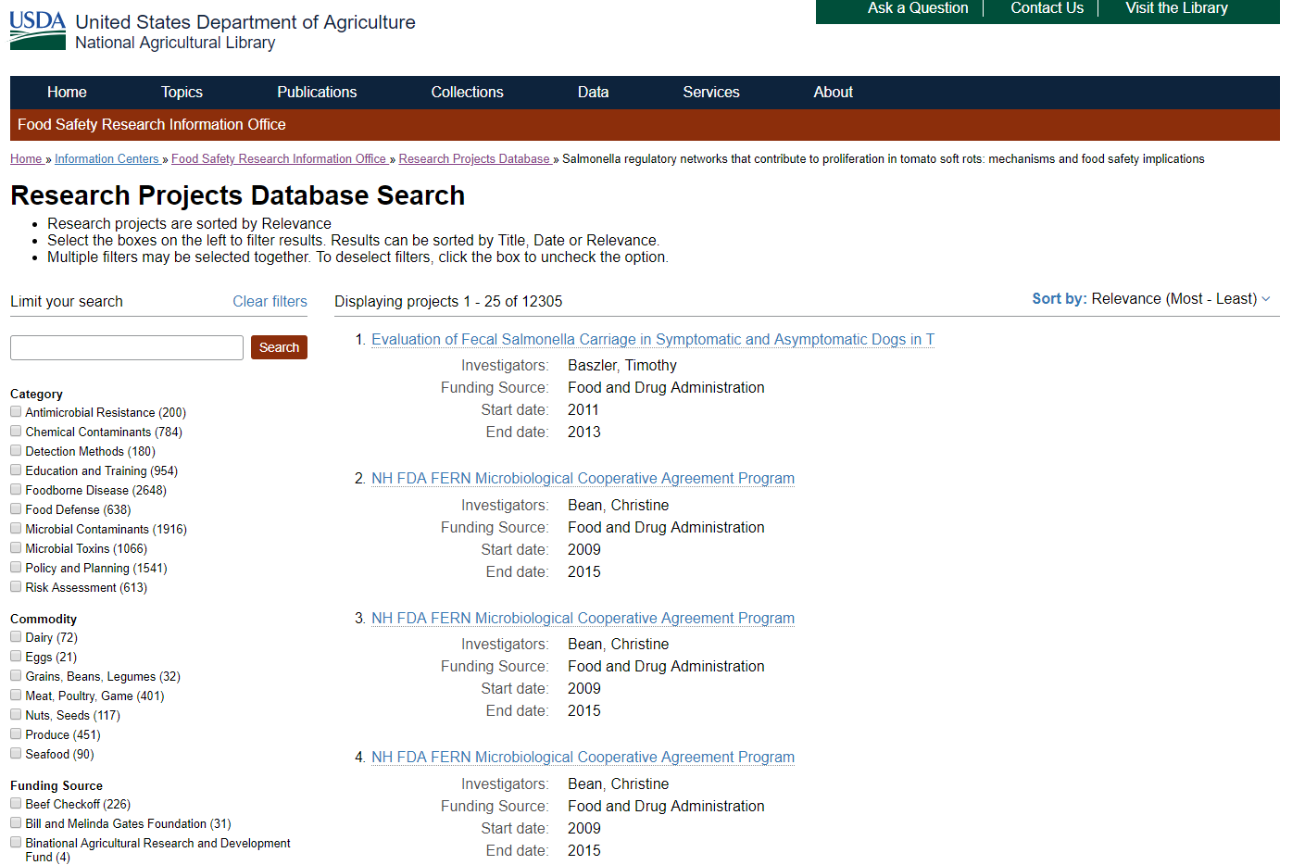
Topics
Research Projects Database

Slide 10
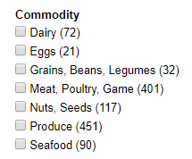
Research Projects Database
Commodities

Slide 11
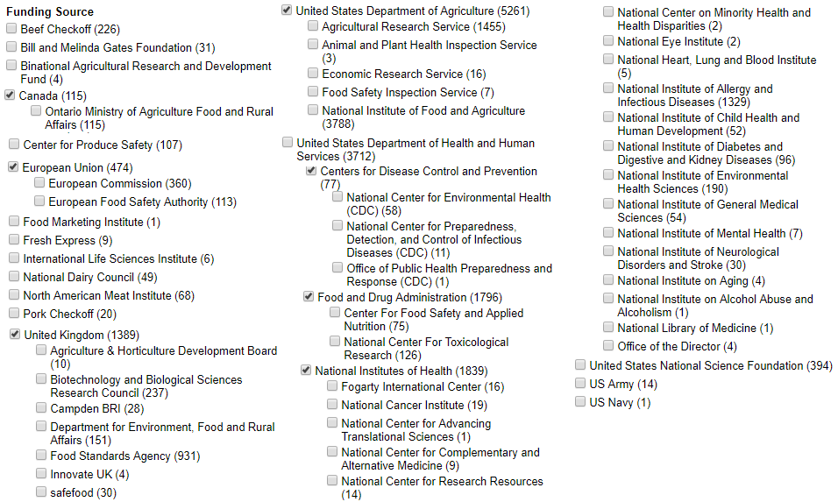
Research Projects Database
Funding Sources
Notes:
animation

Slide 12
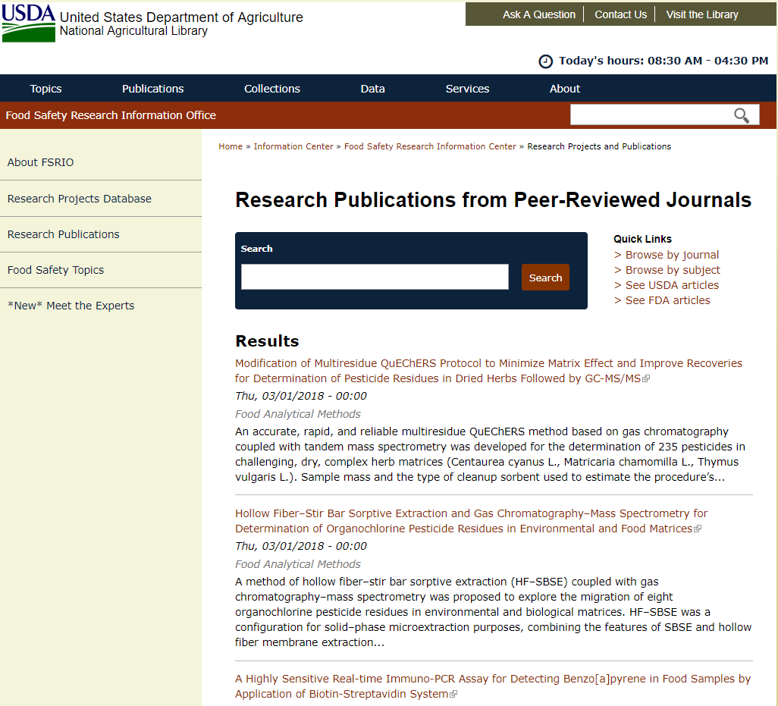
Research Publication Feeds
Provides ready access to the latest food safety research publications, including ahead of print.
Currently tracks 98 journals, expected to increase to 246 journals
Publications generated by these feeds are grouped by:
Journal
Subject

Slide 13
Research Publication Feeds
Quick links to
Browse by journal or subject
See USDA or FDA articles
See most recent publications on the homepage, including ahead of print

Slide 14
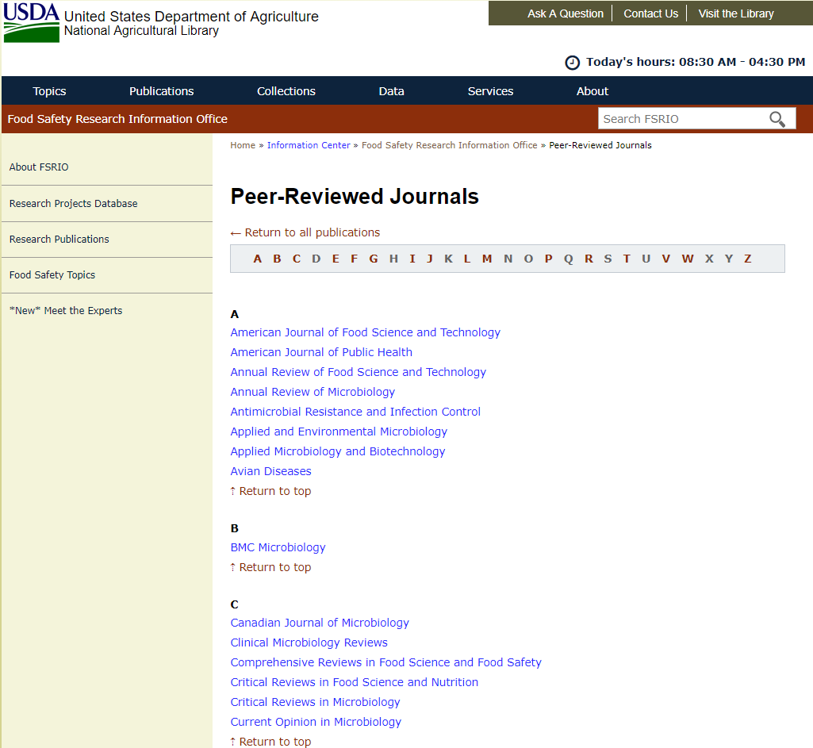
Research Publication Feeds
Browse peer-reviewed journals

Slide 15
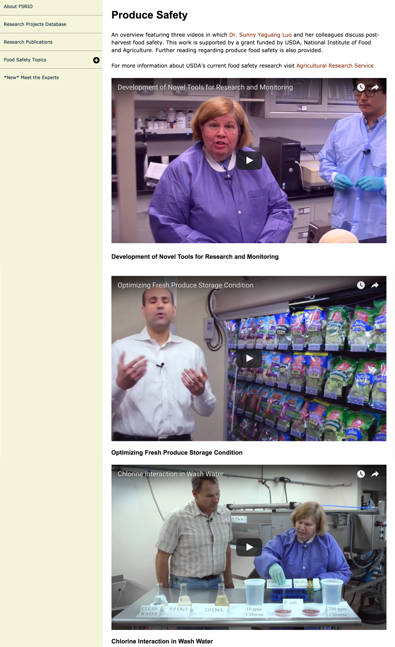
Meet the Experts

Slide 16
Meet the Experts
Features videos highlighting a wide variety of food safety research applications conducted at USDA
This fiscal year, we will be adding presentations and publications on trending food safety topics including mycotoxins, produce, chemistry, produce, and bacterial pathogens.
Currently tracking USDA research, in the future will expand to FDA, NIH, CDC, and NSF
Moving forward, we will track food safety trends and present research in various formats

Slide 17
Contact Information
Wendy Davis
Program Leader, Nutrition & Food Safety
Wendy.Davis-Shaw@ars.usda.gov
Jessica Ault
FSRIO Metadata Librarian
Jessica.ault@ars.usda.gov
Meredith Evans
FSRIO Technical Information Specialist
Molly.Evans@lacfederal.com

