Slide 1
Save-the-date March 6-8, 2019

Slide 2
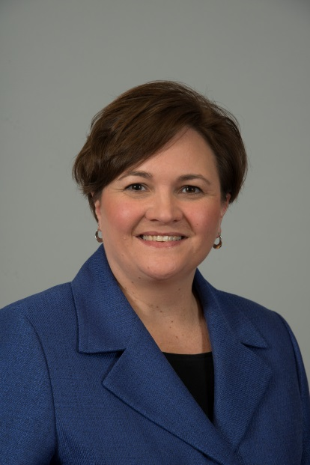
Conference Co-Chairs
Hilary Thesmar, FMI
Mike Robach, Cargill

Slide 3
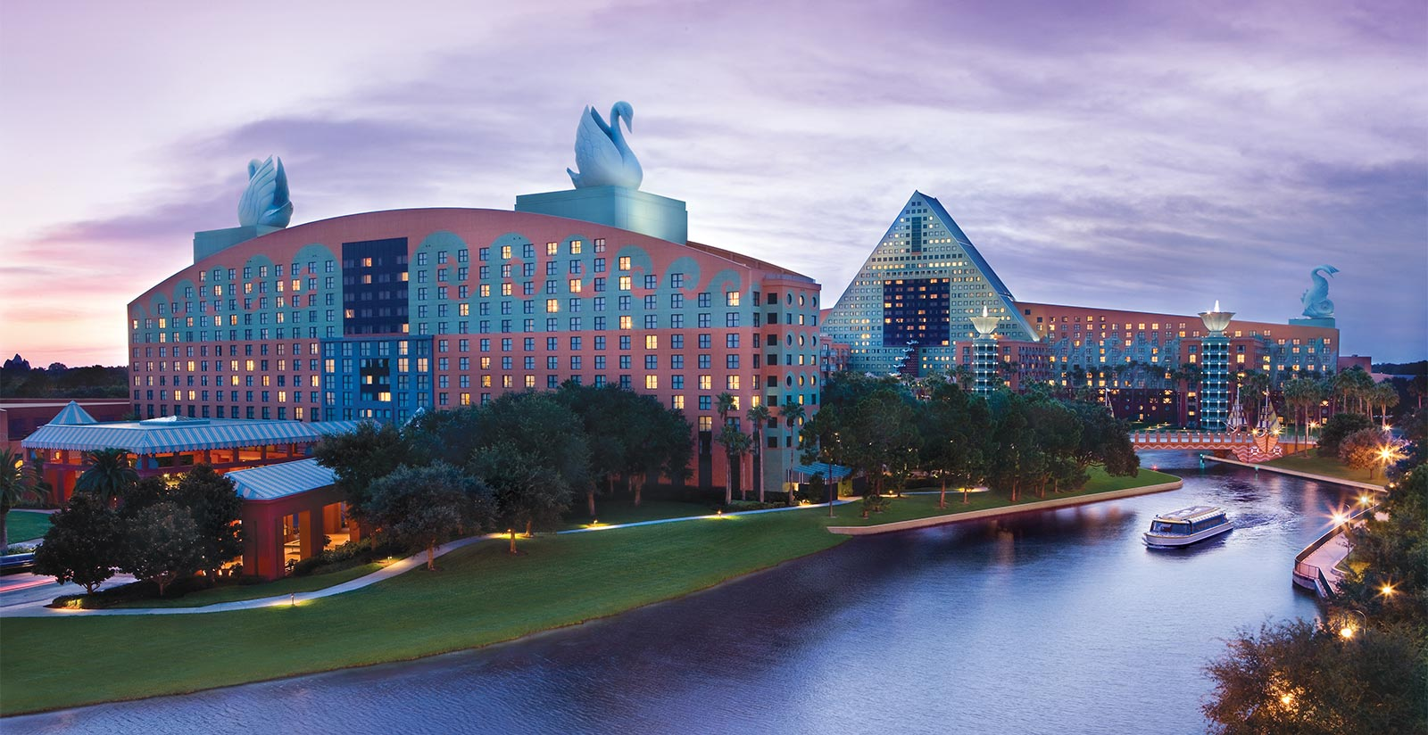
Swan and Dolphin Resort, Orlando

Slide 4
Tracks
1. Program Tools – Refresh Your Outreach Toolbox
fresh, new, and effective ways to advance consumer awareness and behavior
2. Know the Data: Modifying Approaches to Increase Consumer Engagement
how health and food safety educators mine their own data, and other sources of data, including published research, to identify knowledge gaps and to adjust program approaches for engaging and educating consumers.
3. Safe Food Handling in Today’s Food Landscape
food safety education in the context of emerging food and consumer trends and issues.
4. Show It! Hands-on Demonstrations that Engage Consumers

Slide 5
Take part in Abstract Review
Choose a track
Contact Shelley via email or today
Be available between Aug. 6 – Aug. 23 for a committee call

Slide 6
Special Guest Speakers
A chef
Ellie Krieger, nutritionist
Federal agency officials
Leaders in food and health
Expert communicators

Slide 7
Please
Participate in the Marketing Committee
Call Tuesday, June 5 at 2 p.m. EST

Slide 8
Partners
Sponsor the Conference
Invest directly in programming and events for BAC Fighters
Be a recognized sponsor of the Brown Bag webinar series, and the biennial Consumer Food Safety Education conference
Raise your organization’s visibility
Support directly improves BAC Fighters’ effectiveness
98% of 2017 conference attendees reported they will implement lessons they learned in their communities

Slide 9
Sponsor Levels
Platinum
$20,000
Gold
$10,000
Silver
$5,000
Thank you for helping to make the CFSEC 2019 a great success!

